Slide 1
Asynchronous Programming
12 Mar18 | Start
25 Apr 18 | 24
02 May 18 | 35
02 May 18 | 3: 109-116
29 Jun 18 | 3: 117-121
Appendix
Online

Slide 2
Async Programming
Ch | Date
1 | 10 Apr 18
2 | 13 Apr 18
3
4
5
6
7
8
Pro Asynchronous Programming with 2013

Slide 3
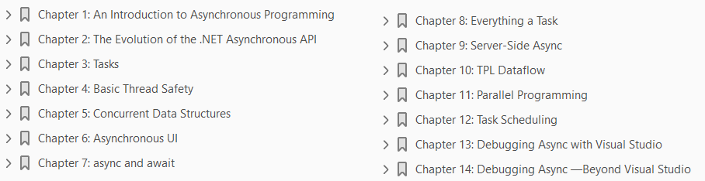

Slide 4
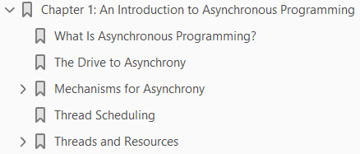
1
An Introduction to Asynchronous Programming

Slide 5
Intro
There are many holy grails in software development, but probably none so eagerly sought, and yet so woefully unachieved, as making asynchronous programming simple.
This isn’t because the issues are currently unknown; rather, they are very well known, but just very hard to solve in an automated way.
The goal of this book is to help you understand why asynchronous programming is important, what issues make it hard, and how to be successful in writing asynchronous code on the .NET platform.

Slide 6
What is Asynchronous Programming?
Most code that people write is synchronous.
In other words, the code starts to execute, may loop, branch, pause, and resume, but given the same inputs, its instructions are executed in a deterministic order.
Synchronous code is, in theory, straightforward to understand, as you can follow the sequence in which code will execute.
It is also generally straightforward to write as long as you understand the problem domain.
The problem is that an application that executes purely synchronously may generate results too slowly or may perform long operations that leave the program unresponsive to further input.
What if we could calculate several results concurrently or take inputs while also performing those long operations?
This would solve the problems with our synchronous code, but now we would have more than one thing happening at the same time (at least logically if not physically).
When you write systems that are designed to do more than one thing at a time, it is called asynchronous programming.

Slide 7
The Drive to Asynchrony
There are a number of trends in the world of IT that have highlighted the importance of asynchrony.
First, users have become more discerning about the responsiveness of applications.
In times past, when a user clicked a button, they would be fairly forgiving if there was a slight delay before the application.
However, with smartphones and tablets, users now expect it to respond to their actions instantaneously and fluidly.
For a developer to give the user the experience they want, they have to make sure that any operation that could prevent the application from responding is performed asynchronously.
Second, processor technology has evolved to put multiple processing cores on a single processor package.
Machines now offer enormous processing power.
However, because they have multiple cores rather than one incredibly fast core, we get no benefit unless our code performs multiple, concurrent, actions that can be mapped on to those multiple cores.
Therefore, taking advantage of modern chip architecture inevitably requires asynchronous programming.

Slide 8
The Drive to Asynchrony |
Last, the push to move processing to the cloud means applications need to access functionality that is potentially geographically remote.
The resulting added latency can cause operations that previously might have provided adequate performance when processed sequentially to miss performance targets.
Executing two or more of these remote operations concurrently may well bring the application back into acceptable performance.
To do so, however, requires asynchronous programming.

Slide 9
Mechanisms for Asynchrony
There are typically three models that we can use to introduce asynchrony:
Multiple machines
Multiple processes
Multiple threads
All of these have their place in complex systems, and different languages, platforms, and technologies tend to favor a particular model.

Slide 10
Multiple Machines
To use multiple machines, or nodes, to introduce asynchrony, we need to ensure that when we request the functionality to run remotely, we don’t do this in a way that blocks the requester.
There are a number of ways to achieve this, but commonly we pass a message to a queue, and the remote worker picks up the message and performs the requested action.
Any results of the processing need to be made available to the requester, which again is commonly achieved via a queue.
As can be seen from Figure 1-1, the queues break blocking behavior between the requester and worker machines and allow the worker machines to run independently of one another.
Because the worker machines rarely contend for resources, there are potentially very high levels of scalability.
However, dealing with node failure and internode synchronization becomes more complex.

Slide 11
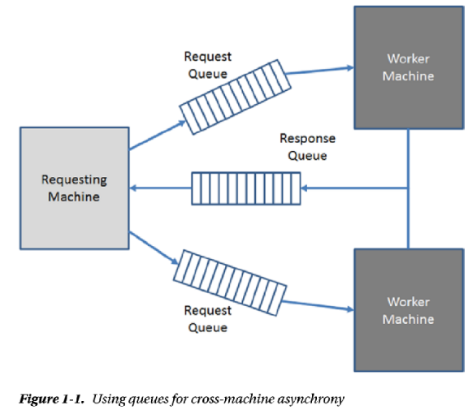
Figure 1-1

Slide 12
Multiple Processes
A process is a unit of isolation on a single machine.
Multiple processes do have to share access to the processing cores, but do not share virtual memory address spaces and can run in different security contexts.
It turns out we can use the same processing architecture as multiple machines on a single machine by using queues.
In this case it is easier to some degree to deal with the failure of a worker process and to synchronize activity between processes.
There is another model for asynchrony with multiple processes where, to hand off long-running work to execute in the background, you spawn another process.
This is the model that web servers have used in the past to process multiple requests.
A CGI script is executed in a spawned process, having been passed any necessary data via command line arguments or environment variables.

Slide 13
Multiple Threads
Threads are independently schedulable sets of instructions with a package of nonshared resources.
A thread is bounded within a process (a thread cannot migrate from one process to another), and all threads within a process share
process-wide resources such as heap memory and
OS resources such as file handles and sockets
The queue-based approach shown in Figure 1-1 is also applicable to multiple threads, as it is in fact a general purpose asynchronous pattern.
However, due to the heavy sharing of resources, using multiple threads benefits least from this approach.
Resource sharing also introduces more complexity in coordinating multiple worker threads and handling thread failure.
Unlike Unix, Windows processes are relatively heavyweight constructs when compared with threads.
This is due to the loading of the Win32 runtime libraries and the associated registry reads.

Slide 14
Multiple Threads |
Therefore, by design on Windows, we tend to prefer using multiple threads to create asynchronous processing rather than multiple processes.
However, there is an overhead to creating and destroying threads, so it is good practice to try to reuse them rather than destroy one thread and then create another.

Slide 15
Thread Scheduling
In Windows, the operating system component responsible for mapping thread execution on to cores is called the Thread Scheduler.
As we shall see, sometimes threads are waiting for some event to occur before they can perform any work (in .NET this state is known as SleepWaitJoin).
Any thread not in the SleepWaitJoin state should be allocated some time on a processing core and, all things being equal, the thread scheduler will round-robin processor time among all of the threads currently running across all of the processes.
Each thread is allotted a time slice and, as long as the thread doesn’t enter the SleepWaitJoin state, it will run until the end of its time slice.
Things, however, are not often equal.
Different processes can run with different priorities (there are six priorities ranging from idle to real time).
Within a process a thread also has a priority; there are seven ranging from idle to time critical.
The resulting priority a thread runs with is a combination of these two priorities, and this effective priority is critical to thread scheduling.

Slide 16
Thread Scheduling |
The Windows thread scheduler does preemptive multitasking.
In other words, if a higher-priority thread wants to run, then a lower-priority thread is ejected from the processor (preempted) and replaced with the higher-priority thread.
Threads of equal priority are, again, scheduled on a round-robin basis, each being allotted a time slice.
You may be thinking that lower-priority threads could be starved of processor time.
However, in certain conditions, the priority of a thread will be boosted temporarily to try to ensure that it gets a chance to run on the processor.
Priority boosting can happen for a number of reasons (e.g., user input).
Once a boosted thread has had processor time, its priority gets degraded until it reaches its normal value.

Slide 17
Threads and Resources
Although two threads share some resources within a process, they also have resources that are specific to themselves.
To understand the impact of executing our code asynchronously, it is important to understand when we will be dealing with shared resources and when a thread can guarantee it has exclusive access.
This distinction becomes critical when we look at thread safety, which we do in depth in Chapter 4.

Slide 18
Thread-Specific Resources
There are a number of resources to which a thread has exclusive access.
When the thread uses these resources it is guaranteed to not be in contention with other threads.
The Stack: Each thread gets its own stack. This means that local variables and parameters in methods, which are stored on the stack, are never shared between threads.
The default stack size is 1MB, so a thread consumes a nontrivial amount of resource in just its allocated stack.
Thread Local Storage: On Windows we can define storage slots in an area called thread local storage (TLS).
Each thread has an entry for each slot in which it can store a value. This value is specific to the thread and cannot be accessed by other threads.
TLS slots are limited in number, which at the time of writing is guaranteed to be at least 64 per process but may be as high as 1,088.
Registers: A thread has its own copy of the register values. When a thread is scheduled on a processing core, its copy of the register value is restored on to the core’s registers.

Slide 19
Thread-Specific Resources |
This allows the thread to continue processing at the point when it was preempted (its instruction pointer is restored) with the register state identical to when it was last running.

Slide 20
Resources Shared by Threads
There is one critical resource that is shared by all threads in a process: heap memory.
In .NET all reference types are allocated on the heap and therefore multiple threads can, if they have a reference to the same object, access the same heap memory at the same time.
This can be very efficient but is also the source of potential bugs, as we shall see in Chapter 4.
For completeness we should also note that threads, in effect, share operating system handles.
In other words, if a thread performs an operation that produces an operating system handle under the covers (e.g., accesses a file, creates a window, loads a DLL), then the thread ending will not automatically return that handle.
If no other thread in the process takes action to close the handle, then it will not be returned until the process exits.

Slide 21
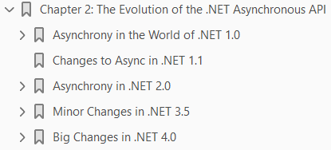
2
The Evolution of the .NET Asynchronous API

Slide 22
Intro
In February 2002, .NET version 1.0 was released.
From this very first release it was possible to build parts of your application that ran asynchronously.
The APIs, patterns, underlying infrastructure, or all three have changed, to some degree, with almost every subsequent release, each attempting to make life easier or richer for the .NET developer.
To understand why the .NET async world looks the way it does, and why certain design decisions were made, it is necessary to take a tour through its history.
We will then build on this in future chapters as we describe how to build async code today, and which pieces of the async legacy still merit a place in your new applications.
Some of the information here can be considered purely as background to show why the API has developed as it has.
However, some sections have important use cases when building systems with .NET 4.0 and 4.5.
In particular, using the Thread class to tune how COM Interop is performed is essential when using COM components in your application.

Slide 23
Intro |
Also, if you are using .NET 4.0, understanding how work can be placed on I/O threads in the thread pool using the Asynchronous Programming Model is critical for scalable server based code.

Slide 24
Asynchrony in the World of .NET 1.0
Even back in 2002, being able to run code asynchronously was important:
UIs still had to remain responsive
background things still needed to be monitored
complex jobs needed to be split up and run concurrently.
The release of the first version of .NET, therefore, had to support async from the start.
There were two models for asynchrony introduced with 1.0, and which you used depended on whether you needed a high degree of control over the execution.
The Thread class gave you a dedicated thread on which to perform your work
The ThreadPool was a shared resource that potentially could run your work on already created threads.
Each of these models had a different API.

Slide 25
System.Threading.Thread
The Thread class was, originally, a 1:1 mapping to an operating system thread.
It is typically used for long-running or specialized work such as
monitoring a device or
executing code with a low priority
Using the Thread class leaves us with a lot of control over the thread, so let’s see how the API works.

Slide 26
The Start Method
To run work using the Thread class you create an instance, passing a ThreadStart delegate and calling Start (see Listing 2-1).
The ThreadStart delegate takes no parameters and returns void.
So that presents a question: how do we get data into the thread?
This was before the days of anonymous delegates and lambda expressions, and so our only option was to encapsulate the necessary data and the thread function in its own class.
It’s not that this is a hugely complex undertaking; it just gives us more code to maintain, purely to satisfy the mechanics of getting data into a thread.

Slide 27
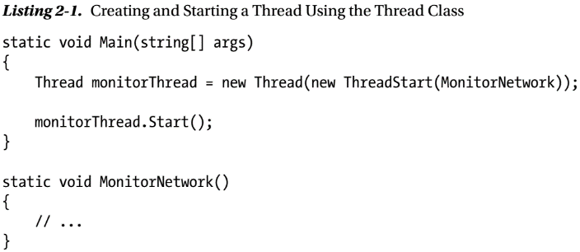
Listing 2-1

Slide 28
Stopping a Thread
The thread is now running, so how does it stop?
The simplest way is that the method passed as a delegate ends.
However, often dedicated threads are used for long-running or continuous work, and so the method, by design, will not end quickly.
If that is the case, is there any way for the code that spawned the thread to get it to end?
The short answer is not without the cooperation of the thread—at least, there is no safe way.
The frustrating thing is that the Thread API would seem to present not one, but two ways: both the
Interrupt and
Abort method
would appear to offer a way to get the thread to end without the thread function itself being involved.

Slide 29
The Abort Method
The Abort method would seem to be the most direct method of stopping the thread.
After all, the documentation says the following:
Raises a ThreadAbortException in the thread on which it is invoked, to begin the process of terminating the thread. Calling this method usually terminates the thread.
Well, that seems pretty straightforward.
However, as the documentation goes on to indicate, this raises a completely asynchronous exception that can interrupt code during sensitive operations.
The only time an exception isn’t thrown is if the thread is in unmanaged code having gone through the interop layer.
This issue was alleviated a little in .NET 2.0, but the fundamental issue of the exception being thrown at a nondeterministic point remains.
So, in essence, this method should not be used to stop a thread.

Slide 30
The Interrupt Method
The Interrupt method appears to offer more hope.
The documentation states that this will also throw an exception (a ThreadInterruptedException), but this exception will only happen when the thread is in a known state called WaitSleepJoin.
In other words, the exception is thrown if the thread is in a known idle situation.
The problem is that this wait state may not be in your code, but instead in some arbitrary framework or third-party code.
Unless we can guarantee that all other code has been written with the possibility of thread interruption in mind, we cannot safely use it (Microsoft has acknowledged that not all framework code is robust in the face of interruption).

Slide 31
Solving Thread Teardown
We are therefore left with cooperation as a mechanism to halt an executing thread.
It can be achieved fairly straightforwardly using a Boolean flag (although there are other ways as well).
The thread must periodically check the flag to find out whether it has been requested to stop.
There are two issues with this approach, one fairly obvious and the other quite subtle.
First, it assumes that the code is able to check the flag. If the code running in the thread is performing a long blocking operation, it cannot look at a flag.
Second, the JIT compiler can perform optimizations that are perfectly valid for single-threaded code but will break with multithreaded code.
Consider the code in Listing 2-2: if it is run in a release build, then the main thread will never end, as the JIT compiler can move the check outside of the loop.
This change makes no difference in single-threaded code, but it can introduce bugs into multithreaded code.
Once you are aware of the potential problem, there is a very simple fix:
to mark the Terminate flag as volatile.

Slide 32
Solving Thread Teardown |
This has two effects: first, to turn off thread-sensitive JIT compiler optimizations; second, to prevent reordering of write operations.
The second of these was potentially an issue prior to version 2.0 of .NET, but in 2.0 the memory model (see sidebar) was strengthened to remove the problem.

Slide 33
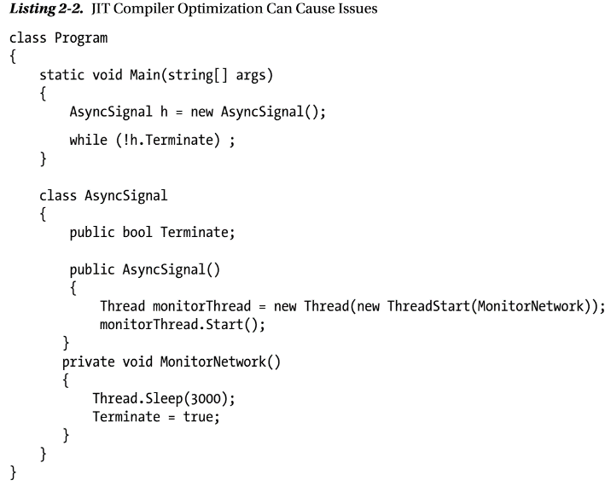
Listing 2-2

Slide 34
MEMORY MODELS
A memory model defines rules for how memory reads and writes can be performed in multithreaded systems.
They are necessary because on multicore hardware, memory access is heavily optimized using caches and write buffering.
Therefore, a developer needs to understand what guarantees are given by the memory model of a platform and, therefore, to what they must pay attention.
The 1.x release of .NET defined its memory model in the accompanying ECMA specification.
This was fairly relaxed in terms of the demands on compiler writers and left a lot of responsibility with developers to write code correctly.
However, it turned out that x86 processors gave stronger guarantees than the ECMA specification and, as the only implementation of .NET at the time was on x86, in reality applications were not actually subject to some of the theoretical issues.
.NET 2.0 introduced a stronger memory model, and so even on non-x86 processor architectures, issues caused by read and write reordering will not affect .NET code.

Slide 35
Another Approach: Background Threads
.NET has the notion of
Foreground threads
background threads
A process is kept alive as long as at least one foreground thread is running.
Once all foreground threads have finished, the process is terminated.
Any background threads that are still running are simply torn down.
In general this is safe, as resources being used by the background threads are freed by process termination.
However, as you can probably tell, the thread gets no chance to perform a controlled cleanup.
If we model our asynchronous work as background threads, we no longer need to be responsible for controlling the termination of a thread.
If the thread were simply waiting for a file to arrive in a directory and notifying the application when it did, then it doesn’t matter if this thread is torn down with no warning.
However, as an example of a potential issue, consider a system where the first byte of a file indicates that the file is currently locked for processing.

Slide 36
Another Approach: Background Threads |
If the processing of the file is performed on a background thread, then there is a chance that the thread will be torn down before it can reset the lock byte.
Threads created using the Thread class are, by default, foreground threads.
If you want a background thread, then you must set the IsBackground property of the thread object to true.

Slide 37
Coordinating Threads (Join)
If code spawns a thread, it may well want to know when that thread finishes; for example, to process the results of the thread’s work.
The Thread class’s Join method allows an observer to wait for the thread to end.
There are two forms of the Join method:
one that takes no parameters and returns void
the other that takes a timeout and returns a Boolean
The first form will block until the thread completes, regardless of how long that might be.
The second form will return true if the thread completes before the timeout or false if the timeout is reached first.
You should always prefer waiting with a timeout, as it allows you to proactively detect when operations are taking longer than they should.
Listing 2-3 shows how to use Join to wait for a thread to complete with a timeout.
You should remember that when Join times out, the thread is still running; it is simply the wait that has finished.

Slide 38
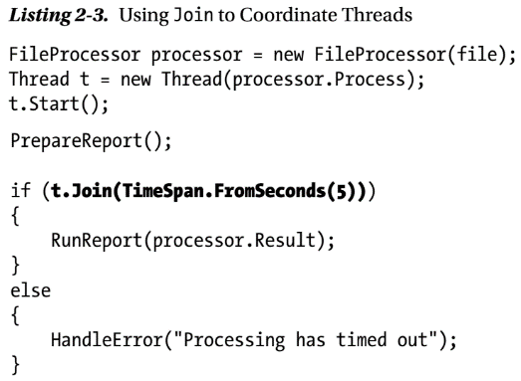
Listing 2-3

Slide 39
THREADING AND COM

Slide 40
Controlling a Thread’s Interaction with COM
One common use of the Thread class that is still important even in .NET 4.0 and 4.5 is to control how that thread behaves when it performs COM work (see the “Threading and COM” sidebar to understand the issues).
If a thread is going to perform COM work, you should try to ensure it is in the same apartment as the COM objects it is going to be invoking.
By default, .NET threads will always enter the MTA.
To change this behavior, you must change the thread’s ApartmentState.
Originally, this was done by setting the ApartmentState property, but this was deprecated in .NET 2.0.
From 2.0 onward you need to use the SetApartmentState method on the thread.

Slide 41
Issues with the Thread Class
The API for the Thread class is fairly simple, so why not use it for all asynchronous work?
As discussed in Chapter 1, threads are not cheap resources:
they are expensive to create, clean up
they consume memory for stack space
require attention from the thread scheduler
As a result, if you have regular asynchronous work to do, continuously creating and destroying the threads is wasteful.
Also, uncontrolled creation of threads can end up consuming huge amounts of memory and causing the thread scheduler to thrash—neither of which is healthy for your application.
A more efficient model would be to reuse threads that have already been created, thus relieving the application code of control of thread creation.
This would then allow thread management to be regulated. This is potentially highly complex code for you to maintain.
Fortunately, .NET already comes with an implementation, out of the box, in the form of the system thread pool.

Slide 42
Using the System Thread Pool
The system thread pool is a process-wide resource providing more efficient use of threads for general asynchronous work.
The idea is this:
Application code passes work to the thread pool (known as a work item), which gets enqueued (see Figure 2-1).
The thread pool manager adds threads into the pool to process the work.
When a thread pool thread has completed its current work item, it goes back to the queue to get the next.
If the rate of work arriving on the queue is greater than the current number of threads can keep up with, the thread pool manager uses heuristics to decide whether to add more threads into the pool.
If threads are idle (there are no more work items to execute), then the thread pool manager will eventually degrade threads out of the thread pool.
As you can see, the thread pool manager attempts to balance the number of threads in the pool with the rate of work appearing on the queue.
The thread pool is capped to ensure the maximum number of threads is constrained.

Slide 43
Using the System Thread Pool |
The heuristics used to decide whether to add new threads into the pool, and the default maximum number of threads in the pool, have changed with almost every version of .NET, as you will see over the course of this chapter.
In .NET 1.0, however, they were as follows:
The default maximum number of worker threads in the thread pool was 25.
This could only be changed by writing a custom Common Language Runtime (CLR)-unmanaged host.
The algorithm for adding new threads into the thread pool was based on allowing half a second for a work item to be on the queue unprocessed
If still waiting after this time, a new thread was added.

Slide 44
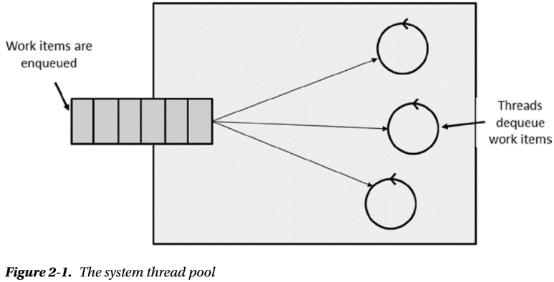
Figure 2-1

Slide 45
Worker and I/O Threads
It turns out there are two groups of threads in the thread pool
Worker
I/O threads
Worker threads are targeted at work that is generally CPU based.
If you perform I/O on these threads it is really a waste of resources, as the thread will sit idle while the I/O is performed.
A more efficient model would be to kick off the I/O (which is basically a hardware operation) and commit a thread only when the I/O is complete.
This is the concept of I/O completion ports, and this is how the I/O threads in the thread pool work.

Slide 46
Getting Work on to the Thread Pool
We have seen the basic mechanics of how the thread pool works but how does work get enqueued?
There are three mechanisms you can use:
ThreadPool.QueueUserWorkItem
Timers
The Asynchronous Programming Model (APM)

Slide 47
ThreadPool.QueueUserWorkItem
The most direct way to get work on to the thread pool is to use the API ThreadPool.QueueUserWorkItem.
This method takes the passed WaitCallback delegate and, as the name suggests, wraps it in a work item and enqueues it.
The work item is then picked up by a thread pool worker thread when one becomes available.
The WaitCallback delegate takes an object as a parameter, which can be passed in an overload of ThreadPool.QueueUserWorkItem.

Slide 48
Timers
If you have work that needs to be done asynchronously but on a regular basis and at a specific interval, you can use a thread pool timer.
This is represented by the class System.Threading.Timer.
Creating one of these will run a delegate, on a thread pool worker thread, at the passed interval starting after the passed due time.
The API takes a state object that is passed to the delegate on each invocation.
The timer stops when you dispose it.

Slide 49
The APM
By far the most common way to run work on the thread pool, before .NET 4.0, was to use APIs that use a pattern called the Asynchronous Programming Model (APM).
APM is modeled by
a pair of methods and
an object that binds the two together, known as a call object
To explain the pattern, let’s take an API for obtaining search results that has a synchronous version that looks like Listing 2A-1.
The pattern has traditionally sat alongside a synchronous version, although this is not a requirement, so with APM you get two additional methods.
These methods are the synchronous name prefixed with Begin and End, respectively.
The signatures of these two methods are also very specific; for this example, they are shown in Listing 2A-2.
BeginGetResults takes the same parameters as the synchronous version with an additional two (we’ll come to these shortly) and always return an IAsyncResult.
The object that implements IAsyncResult is known as the call object and is used to identify the asynchronous call in progress.

Slide 50
The APM |
The EndGetResults method takes the output (and any ref) parameters of the synchronous version, as well as the call object (in the form of IAsyncResult) and returns the same thing as the synchronous version.
If the EndGetResults method is called before the work is completed, then the method blocks until the results are available.
The idea is that the BeginGetResults method enqueues the work and returns immediately, and the caller can now get on with other work.
In most cases the work will occur asynchronously on the thread pool.
The EndGetResults method is used to retrieve the results of the completed asynchronous operation.

Slide 51
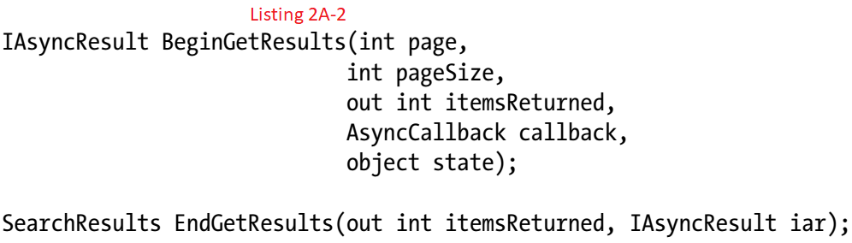
Listing 2A-1 || 2A-2

Slide 52
WHY DOES THE BEGIN METHOD TAKE OUT PARAMETERS?
Something that might strike you as odd is that the Begin method takes out parameters as well as standard and ref ones.
Normally out parameters come into play only when the operation is complete, so why are they on the Begin method? It turns out this is the abstraction leaking.
The CLR has no notion of out parameters; it is a C# language idiom.
At the CLR level, out parameters are simply ref parameters, and it is the C# compiler that enforces a specific usage pattern.
Because APM is not a language-specific feature, it must conform to the needs of the CLR.
Now ref parameters can be both inputs and outputs; therefore, the CLR does not know that these out parameters are only used for output and so they must be placed on the Begin method as well as the End method.

Slide 53
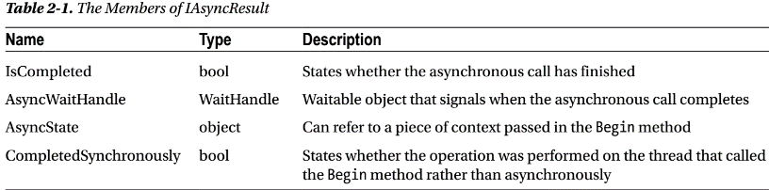
IAsyncResult
Why does the call object implement an interface at all?
Why not just use it as an opaque token?
It turns out that most of the members of the interface can be useful.
There are four members on the interface, as described in Table 2-1.
As we shall see, IsCompleted, AsyncWaitHandle, and AsyncState all have their uses.
CompletedSynchronously, on the other hand, turns out to be of little practical use and is there purely to indicate that the requested work was, in fact, performed on the thread that called the Begin method.
An example where this might happen is on a socket where the data to be read has already arrived across the network.

Slide 54
Dealing with Errors
Things don’t always go to as planned.
It is quite possible that the async operation might fail in some way. The question is, what happens then?
In .NET 1.0 and 1.1 unhandled exceptions on background threads were silently swallowed.
From .NET 2.0 onwards an unhandled exception, on any thread, will terminate the process.
Because you are not necessarily in control of the code that is executing asynchronously (e.g., an asynchronous database query), the process arbitrarily terminating would be an impossible programming model to work with.
Therefore, in APM, exceptions are handled internally and then rethrown when you call the End method.
This means you should always be prepared for exceptions to calling the End method.

Slide 55
Accessing Results
One of the powerful things about APM, when compared with using the Thread API, is the simplicity of accessing results.
To access results, for reasons we hope are obvious, the asynchronous call must have finished.
There are three models you can use to check for completion, and which you use depends on your requirements:
Polling for completion
Waiting for completion
Completion notification

Slide 56
Polling for Completion
Imagine you are building a UI and need to perform some long-running task (we talk about async and UI in much more detail in Chapter 6).
You should not perform this work on the UI thread, as its job is to keep the UI responsive.
So you use APM via a delegate (more on this shortly) to put the task in the thread pool, and then you need to display the results once available.
The question is how do you know when the results are available? You can’t simply call the End method, as it will block (because the task isn’t complete) and stop the UI; you need to call it once you know the task is finished.
This is where the IsCompleted property on IAsyncResult comes in.
You can call IsCompleted on, say, a timer and call the End method when it returns true.
Listing 2-4 shows an example of polling for completion.

Slide 57
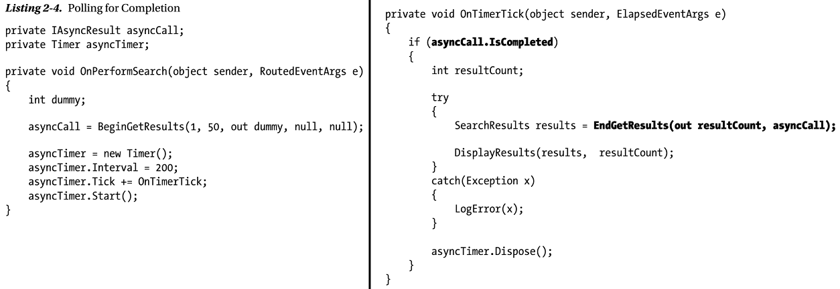
Listing 2-4

Slide 58
Waiting for Completion
Although polling fits some use cases, it is not the most efficient model.
If you can do no further useful work until the results are available, and you are not running on a UI thread, it is better simply to wait for the async operation to complete.
You could just call the End method, which achieves that effect.
However, if the async operation became stuck in an infinite loop or deadlocked, then your waiting code would wait forever.
It is rarely a good idea to perform waits without timeouts in multithreaded code, so simply calling the End method should be avoided.
Instead you can use another feature of IAsyncResult: the AsyncWaitHandle.
WaitHandles are synchronization objects that signal in some specific circumstance (we’ll talk more about them in Chapter 4).
The AsyncWaitHandle of IAsyncResult signals when the async operation has finished.
The good thing about WaitHandles is that you can pass a timeout when you wait for them to signal.
Listing 2-5 shows an example of using AsyncWaitHandle.

Slide 59
Waiting for Completion |
However, there is a problem in Listing 2-5.
As explained in the “Housekeeping Is Important” sidebar, in APM you need to call the End method if you call the Begin method.
Notice in the code in Listing 2-5 that in the event of a timeout, the End method isn’t called.
There is a fundamental problem: you’ve timed out, which suggests the async operation is somehow blocked, and so if we call the End method our code will block as well.
There isn’t really a solution to this issue, so although it appears to be an obvious use case, you should generally avoid AsyncWaitHandle.

Slide 60
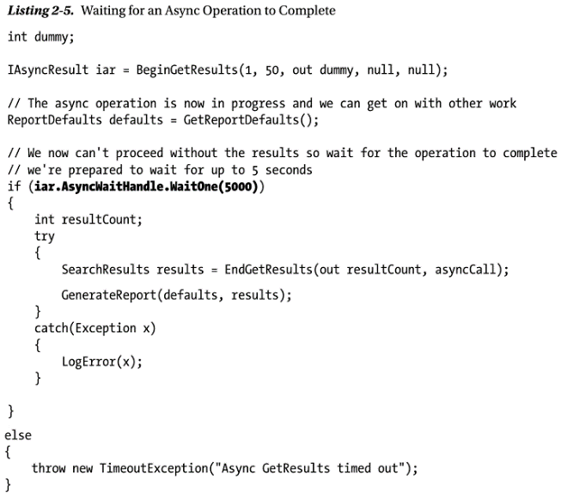
Listing 2-5

Slide 61
HOUSEKEEPING IS IMPORTANT
The async operation may have to allocate resources to track completion; AsyncWaitHandle is an example of this.
When is it safe for these resources to be freed up?
They can only be safely cleaned up when it is known they are no longer required, and this is only known when the End method is called.
It has always been an issue—though one that wasn’t documented until .NET 1.1—that if you call the Begin method in APM, then you must call the End method to allow resources to be cleaned up, even if you don’t care about the results.
Failing to do so means resources may be leaked.

Slide 62
Completion Notification
Probably the most flexible model for knowing when the operation is complete is to register a completion callback.
One note of caution, however, is that this flexibility comes at a cost in terms of complexity, particularly when working in GUI frameworks, which have a high degree of thread affinity.
Recall the signature of BeginGetResults; there were two additional parameters when compared to the synchronous version: an AsyncCallback delegate and an object.
The first of these is the completion callback that gets invoked when the async operation completes.
As you know the operation is complete, you can now safely call the EndGetResults, knowing that it will not block anymore.
AsyncCallback is defined as follows:
Listing 2-6 shows the callback mechanism in action.

Slide 63
Completion Notification |
This all seems very straightforward but, critically, you must remember that the callback will not be executing on the main thread; it will run on a thread pool thread.
As a result, in GUI applications you will not be able to update the UI directly.
GUI frameworks provide built-in mechanisms to move work back onto the UI thread.
We will look at this very briefly, shortly and in much more detail in Chapter 6.
The other issue to take note of is to remember that the End method may throw an exception if the async work didn’t complete successfully.
If you do not put exception-handling code around this call, and an exception happens, then your process will terminate, as this is running on a background thread with no exception handlers higher up the stack.

Slide 64
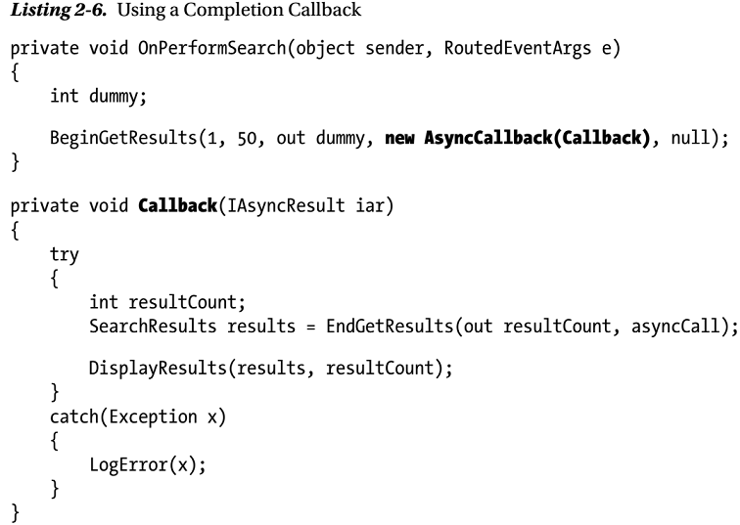
Listing 2-6

Slide 65
APM in the Framework
APM appears in many APIs in the .NET Framework.
Typically, anywhere I/O takes place, there is an associated APM pair of methods.
For example, on the WebRequest class we have the following three methods:
WebResponse GetResponse( );
IAsyncResult BeginGetResponse(AsyncCallback callback, object state);
WebResponse EndGetResponse(IAsyncResult iar);
GetResponse is the synchronous version.
This performs an HTTP or FTP request, which therefore may take some time.
Blocking a thread while the network I/O is taking place is wasteful, and so an APM pair of methods is also provided that use I/O threads in the thread pool to perform the request.
As we shall see in chapter 9, this idea is very important in building scalable server solutions.
Let's look at Listing 2-7, an example of using this API, as this will draw out some more important issues with APM.
As you can see in Listing 2-7, the API is quite straightforward. However, one important rule is that you must call the End method on the same object on which you call the Begin method.

Slide 66
APM in the Framework |
This presents a problem with the code in Listing 2-7 as the Callback method cannot see the WebRequest object.
One obvious way around this is to make the WebRequest local variable into a member variable.
This works fine in simple cases, but what if we wanted to fire off several of these async web requests at the same time?
We would need separate fields for each request and some mechanism for the Callback method to call EndGetResponse on the correct one. This is obviously not a scalable solution.
Fortunately there is another parameter in APM that we have not yet discussed: the last one, of the type object, often named state.
Whatever we pass as this parameter is available via the AsyncState property on IAsyncResult.
Using the async state object to pass the WebRequest gives us a far more encapsulated solution for calling the EndGetResponse method on the right instance in Callback. Listing 2-8 shows this pattern in action.
Of course I/O isn’t just about web requests. APM is implemented on all of the main I/O-based classes:
Of course, not all long-running code is I/O based; what about sections of my code that you want to run asynchronously? Can APM help you there?

Slide 67
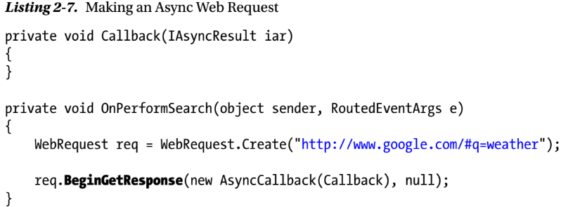
Listing 2-7

Slide 68
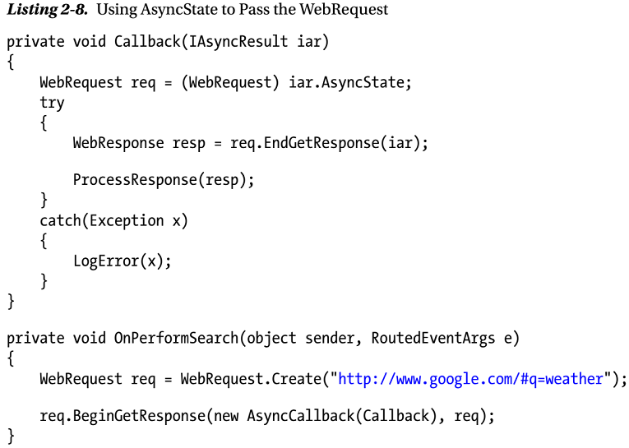
Listing 2-8

Slide 69
APM and Delegates
You can use APM with any arbitrary code by wrapping the operation in a delegate.
Delegates have APM built in to execute the code on a worker thread in the thread pool.
Let’s have a look at what the compiler does with a delegate using the following declaration:
Figure 2-2 shows the ILDASM output after the compiler has compiled this delegate.
As you can see, the Invoke method has the same signature as the delegate and then the output has the corresponding pair of APM methods BeginInvoke and EndInvoke.
Because delegates support APM, you can run any piece of arbitrary code asynchronously on the thread pool fairly easily.
However, remember that your code becomes more complex as a result, because APM changes the structure of the synchronous code. Suppose you want to make the code in Listing 2-9 asynchronous.
If you had a delegate that took a string and returned a string, then you could wrap the Decrypt method in a delegate instance and call BeginInvoke (see Listing 2-10).

Slide 70
APM and Delegates |
As you can see from Listing 2-10, the asynchronous version of the code is structured very differently from the synchronous version.
Synchronous code is generally easier to understand than asynchronous code, so in an ideal world both versions would look very similar.
However, to get to that point we have to continue our journey.

Slide 71
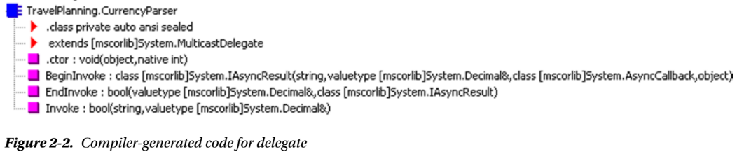
Figure 2-2

Slide 72
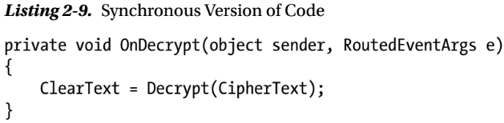
Listing 2-9

Slide 73
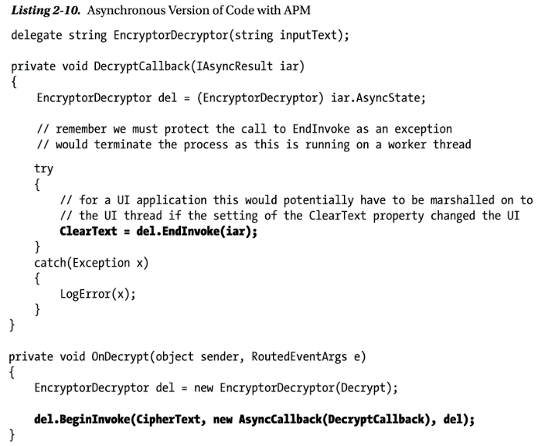
Listing 2-10

Slide 74
Changes to Async in .NET 1.1
The .NET 1.1 release did not make any dramatic changes to the async world of .NET.
One change, already mentioned, was the fact that the documentation changed to explicitly state that in APM, the End method must be called if the Begin method is.
The other change was in the thread pool defaults.
Remember that in 1.0 the default maximum size of the thread pool was 25 threads.
In 1.1 this became 25 threads per CPU.
So on a four-core machine the default maximum size was 4 × 25 = 100 threads.
Before .NET 2.0, then, we had two distinct mechanisms for performing asynchronous work:
the Thread class
the Thread Pool
The Thread class gave you full control but forced you to manage the thread very explicitly.
Also, the Thread class, if used for more general purposes, asynchrony could lead to large numbers of threads being created, consuming a lot of resources.

Slide 75
Changes to Async in .NET 1.1 |
The thread pool, on the other hand, allows you to use threads managed by a system component.
These threads, with APM, give a good general-purpose programming model, but it is not without issues:
APM makes your asynchronous code very different from the synchronous version, making it more complex to support.
Care must be taken with GUI technologies when using callbacks because the callback will generally be running on the wrong thread to interact with the UI.
You must remember to call the EndXXX method, even when you don’t care about results, to allow the asynchronous code to clean up any resources it needs to allocate to perform the work.

Slide 76
Asynchrony in .NET 2.0
Version 2.0 of .NET introduced a number of important innovations in the Async API.
One goal was to try to simplify common async tasks that were causing people issues.
Another driver behind the changes was the ability of SQL Server to host CLR-based code.

Slide 77
Logical and Physical Separation
SQL Server had very specific requirements of the CLR to allow it to become a host for managed code.
It needed to be able to take a lot of control over the CLR execution,
such as memory allocation,
controlling when and if garbage collection (GC) takes place,
what code is and isn’t allowed to do,
how execution is mapped on to threads, and much more
For SQL Server to control the mapping of execution to threads, it has to control what the CLR views as a thread, which in theory might not be a thread in the unmanaged sense.
To make this happen, the CLR team separated the notion of a managed thread from a physical thread.
The method call that allowed you to get hold of the thread ID, (AppDomain.GetCurrentThreadId( )), was deprecated and a new property of the thread class was created, called ManagedThreadId.
Although this separation is real in API terms, in reality, for all managed code, a managed thread still maps on to an unmanaged thread.

Slide 78
Logical and Physical Separation |
However, in theory a hosting process could change that mapping, and so code should not rely on running on the same physical thread over the lifetime of a managed thread.
If you call APIs that have native thread affinity (e.g., certain synchronization objects rely on being acquired and released on the same native thread), then the CLR needs to be forced to make the mapping from managed thread to native thread fixed.
There are two methods on the Thread class that control this:
BeginThreadAffinity and
EndThreadAffinity
In normal circumstances you should never need to call these methods; however, the APIs that rely on thread affinity already wrap these calls up internally.

Slide 79
Passing Data into a Thread
We saw that previously, getting data into a thread in an encapsulated way involved creating a class to wrap the thread function.
.NET 2.0 introduced a new constructor on the Thread class that took a ParameterizedThreadStart delegate instead of a ThreadStart delegate.
The key difference is that the ParameterizedThreadStart delegate takes an object as a parameter:
Now to get data into the thread you simply use a method with a matching signature (one that returns void and takes a single parameter of type object) and pass the data to the Thread's Start method.
Listing 2-11 shows an example of this.
Notice that, in the thread function, the code needs to cast the passed parameter to the type it actually needs.
If the code is refactored and the code creating the thread changes the type of the parameter object, the compiler will not catch that there is a problem, and the failure will occur at runtime.

Slide 80
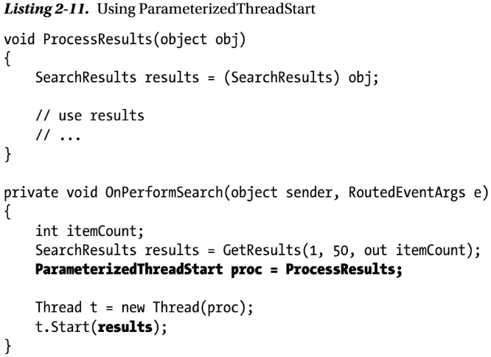
Listing 2-11

Slide 81
Closures
For C# developers, .NET 2.0 saw the introduction of anonymous methods with their associated feature of closure (capturing the state of variables that are in scope).
In many ways closures provided the most natural way for many async tasks.
For example, the code in Listing 2-11 becomes much simpler with closures, as can be seen in Listing 2-12.
Closures also make life simpler when working with APM.
As shown in Listing 2-13, it allows a simple model of accessing the right object to call the End method without having to smuggle it across in the async state.

Slide 82
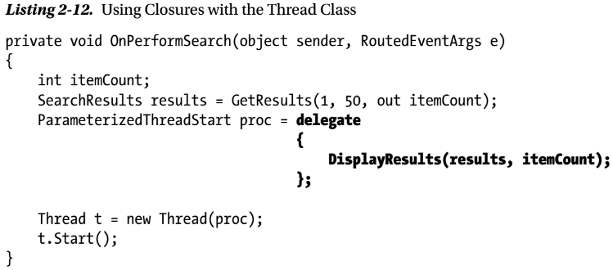
Listing 2-12

Slide 83
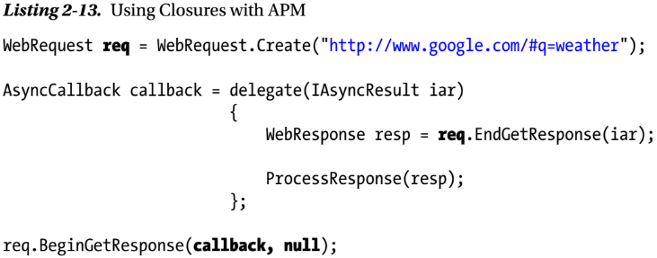
Listing 2-13

Slide 84
SynchronizationContext
As we saw earlier, there are special considerations when using async and UI because UI objects have thread affinity (they must be manipulated on the thread that created them).
Because of this, UI frameworks provide mechanisms to specify work that needs to be carried out on the UI thread:
Windows Forms has the BeginInvoke method on the Control class
WPF and Silverlight have the dispatcher
The problem is that building a component that uses async internally becomes difficult because how marshalling code on to the UI thread is done is dependent on the framework under which the component is running.
The solution to this is to provide a common abstraction over the different underlying mechanisms, and .NET 2.0 introduced one in the form of SynchronizationContext (see Listing 2-14).
The programming model works as follows:
On the UI thread, get hold of the SynchronizationContext using the static Current property

Slide 85
SynchronizationContext |
On the background thread, use the SynchronizationContext Send or Post to perform the work wrapped in the SendOrPostCallback delegate on the UI thread (see Listing 2-15).
Post is a “fire and forget” where the UI thread work is performed asynchronously; Send is synchronous in that the call blocks until the UI thread work has been performed.
In general you should prefer Post as it is easier to end up in a deadlock with Send; however, occasionally Post can lead to race conditions if the background thread continues processing, having made assumptions about the state of the UI.
SynchronizationContext brings sanity to performing async work within different frameworks.
This is especially important if you want to provide infrastructure that can automate some of the work.

Slide 86
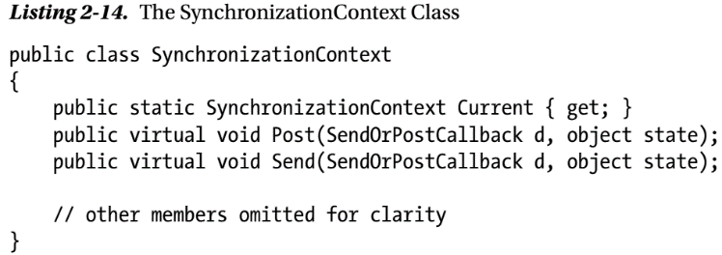
Listing 2-14

Slide 87
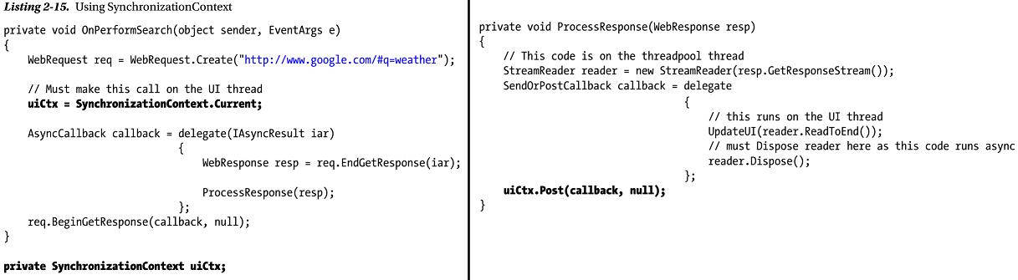
Listing 2-15

Slide 88
Event-Based Asynchronous Pattern
APM has had some issues in terms of
In .NET 2.0 Microsoft introduced another async pattern called the Event-Based Asynchronous Pattern (EAP).
The idea is that each operation has a pair of members:
a method to start the async work
an event that fires when the operation is complete
This pattern was evident on the proxies generated with Add Web Reference in Visual Studio and also on the WebClient class.
As an example, let’s have a look at WebClient in Listing 2-16.
As Listing 2-16 shows, with EAP, before calling the async method you wire up an event (if you wire up the event afterward, there would be a race condition between the completion and the event wire-up).
When the async operation completes, the event is fired.

Slide 89
Event-Based Asynchronous Pattern |
Notice that we can update the UI directly from this event handler, as it uses SynchronizationContext under the covers to fire the event on the UI thread.
The result of the async operation is available as the Result property on the event’s event arguments.

Slide 90
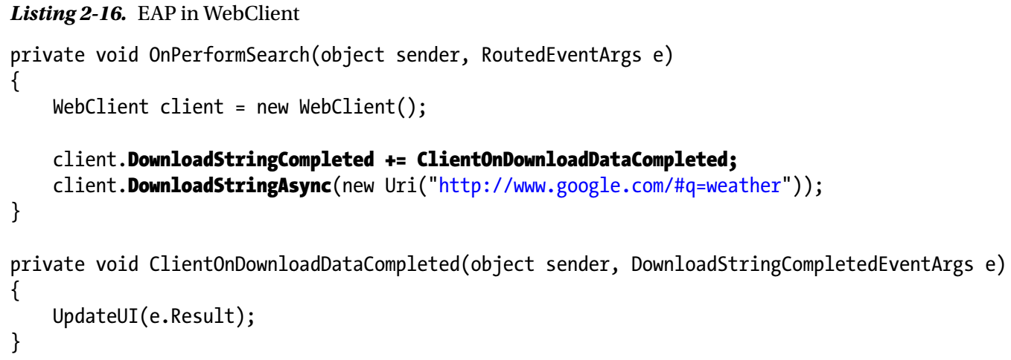
Listing 2-16

Slide 91
Error Handling in EAP
Because completion is pushed in the form of an event rather than by making a call, error handling needs to work differently.
EAP event arguments derive from AsyncCompletedEventArgs.
One of the members of AsyncCompletedEventArgs is an Error property that contains any exception that occurred during the async processing.
You should check that this is null before accessing the Result (an exception will be thrown if you access the Result and there was an error).
Listing 2-17 shows EAP error handling in action.
However, in some ways we’ve taken a step backwards.
As developers, we have moved away from using return codes to signify error because they were so easy to ignore; instead we moved to using exception handling.
EAP really takes us back to return codes, in that if the async operation doesn’t produce any results, then it’s very easy to ignore that an error has occurred.

Slide 92
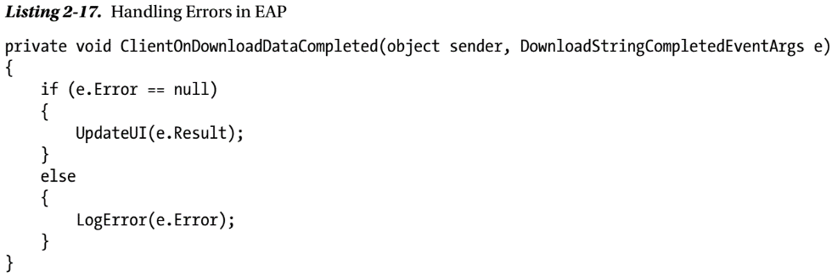
Listing 2-17

Slide 93
EAP and Cancellation
In EAP, APIs are meant to support cancellation via a single CancelAsync method or a cancel method associated with each async operation.
There is no magic here; however, it is purely a cooperative model in that the API is meant to respond to a request to cancel in the implementation of the async operation.
If an operation was cancelled, then the event arguments of the completion event have the Boolean Cancelled property (another member of AsyncCompletedEventArgs) set to true.

Slide 94
Multiple Async Requests
There is a problem with EAP as so far described.
What would happen if the async operation were called a second time before the first async operation completes?
When the completion event fires, how do you know which operation the event relates to?
If an EAP API supports multiple invocations, then it should have an overload of the async operation that takes an object that can be used for correlation (matching requests and their results).
So, for example, WebClient has another version of DownloadStringAsync with the following signature:
Whatever gets passed as the userToken gets set on the event arguments as the UserState property when the associated completion event fires.
This allows you to match the async operation to its completion.
If an EAP API does not support multiple concurrent invocations, then it should throw an exception if invoked again while an existing async operation is in progress.

Slide 95
Multiple Async Requests |
EAP fixes one of the issues with APM by automatically marshalling the completion to the UI thread, and now gives us a standard model for cancellation.
However, you still have very different code in async and synchronous invocations, and error handling is not ideal.

Slide 96
Minor Changes in .NET 3.5
.NET 3.0 was a release of libraries
WCF
WPF
WF
with no changes to the async API or infrastructure, so the next change in the .NET async world was .NET 3.5.
This shipped with a service pack for CLR 2.0 that, among other things, changed the thread pool heuristics.
In terms of the framework class library, however, there were no significant changes to how the async API looked.
There was one .NET 3.5 feature that has changed the way async code is now commonly written.
Lambda expressions are very often used to define delegates used for async work.
Also, the introduction of a rich set of generic delegate types generally removed the need to create your own delegate types to be invoked asynchronously.

Slide 97
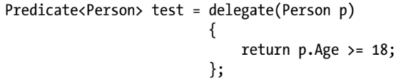
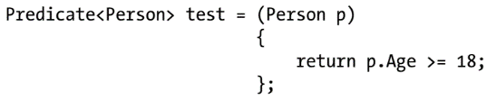
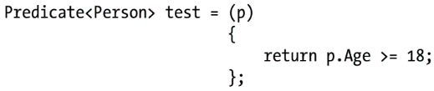
Lambda Expressions
.NET 2.0 introduced anonymous delegates and closure.
However, it turned out that we were commonly telling the compiler things it could already work out for itself.
Consider the following anonymous delegate:
Let’s start removing the things the compiler could work out. To begin with, the delegate keyword is superfluous as the compiler knows Predicate<T> is a delegate type:
We don’t need to specify the type of p as the compiler knows that the parameter for Predicate<Person> is a Person:

Slide 98
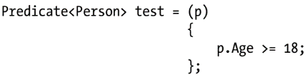
Lambda Expressions |
Predicate<T> returns a Boolean and the return expression evaluates to a Boolean.
There is just one statement in the body, so it must be the return. So let's omit the return keyword:
We only have one statement—we surely don’t need braces:
There is only one parameter, so we could omit the parentheses:
Last, we do need to separate the parameter from the lambda body, so we use the symbol =>:

Slide 99
Lambda Expressions ||
This is a lambda expression.
There are other, more complex forms of lambda expression:
multiple or no parameters require the use of parentheses and
multiple statements in the body require the use of braces and an explicit return.
Why are lambda expressions often used to model asynchronous work?
There are two main reasons:
first, closure simplifies getting data into the asynchronous operation; and
second, quite often the actual code that needs to run asynchronously is quite brief (in terms of syntax)
so creating a whole new method for this clouds readability.

Slide 100
Thread Pool Heuristics in .NET 3.5
Remember from .NET 1.1 that the default maximum number of threads in the thread pool was 25 per core, and the algorithm for adding new threads was to pause for half a second, waiting for a thread to become idle, before adding a new thread into the pool.
.NET 3.5 changed the maximum number of threads in the thread pool to 250 per core.
On, say, an eight-core machine, this gives a maximum size to the thread pool of 2,000 threads.
Each thread will consume 1MB of stack space, so simply creating these threads will consume 2GB of data.
This seems to fly in the face of one of the purposes of using thread pools: namely, to constrain the number of threads—2,000 is not much of a constraint.
However, the algorithm to add more threads to the thread pool was also changed to increase the wait time exponentially as the number of threads increases.
Why did the CLR team feel it necessary to increase the maximum number of threads tenfold?
To understand this change, we need to look at what problem they were trying to solve.
Consider the code in Listing 2-18.

Slide 101
Thread Pool Heuristics in .NET 3.5 |
This code seems quite innocuous.
However, what if this code were invoked from a thread pool thread?
Remember that EndInvoke will block until the async method completes.
Now, what if all threads in the thread pool were running this code?
The async method would never start because no thread was available and no thread would ever become available, because they are all waiting for this code to finish.
It has essentially deadlocked the thread pool.
You might argue that this is a heavily contrived problem; that people generally don’t spawn thread pool work from thread pool threads.
And in many cases that is true—unless all of your code is running within a framework that always runs on thread pool threads like ASP.NET.
Thread pool deadlock was an issue that people were experiencing in the field, so the .NET team decided to solve it by making sure another thread could always be added to break the deadlock—hence the tenfold increase in the maximum number of threads in the thread pool.

Slide 102
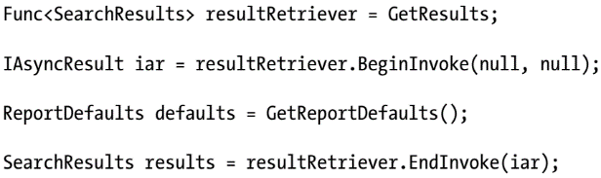
Listing 2-18

Slide 103
Big Changes in .NET 4.0
Part of the .NET 4.0 release was the Parallel Framework Extensions (PFx).
The goal of this library was to provide support for parallelizing algorithms, but along the way it delivered an entirely new model for async processing in .NET.
We are going to spend some time discussing the new API in the next few chapters.
However, using this library potentially creates a lot of thread pool work to which the existing structure of the thread pool was poorly suited so let’s take a look at what was changed behind the scenes to enable this new API to work efficiently.

Slide 104
Remodeling the Thread Pool Queue
Prior to .NET 4.0 the thread pool queue was a linked list of work items.
Imagine lots of cores are generating lots of work items.
There are two issues that are going to become apparent:
The thread pool will become a large data structure with a very large number of references.
This is an expensive for the Garbage Collector to deal with during its mark phase.
A linked list is a terrible data structure for concurrent manipulation.
Processing across the cores would have to be serialized as it updated the queue (see Figure 2-3).
In .NET 4.0 the thread pool queue was redesigned with the new requirements of PFx in mind.
Instead of using a simple linked list, the queue was built with arrays of work items with the arrays connected into a linked list.
This means that there are a lot fewer references, and that adding and moving work items often will simply involve array index manipulation, which is a much cheaper way to make thread safe (see Figure 2-4).

Slide 105
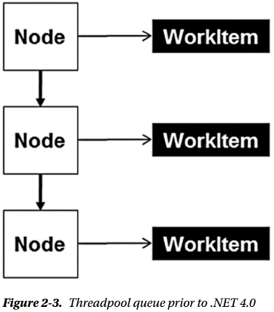
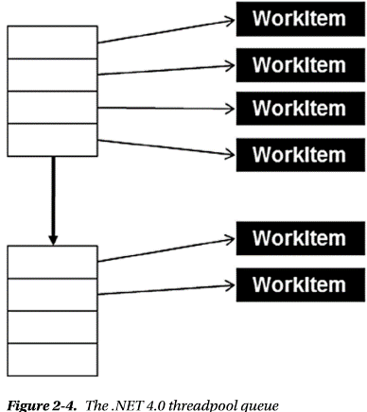
Figure 2-3 || 2-4

Slide 106
Work-Stealing Queues
As we explained in Chapter 1, processors have caches.
If you need to spawn async work that uses the same data that you have been processing, it would be most efficient in terms of data access to execute the work on the same processor, as then the data may well be read from cache rather than main memory.
So if all of the cores are generally busy, then trying to get related work on to the same core potentially would be a significant performance improvement.
The internals of the thread pool have been remodeled to give each thread its own queue.
If a thread pool thread creates async work using the new API, then by default it will be put on the thread’s “local” queue.
When a thread finishes its current work item, it looks for new work items in the following order:
It looks on its local queue.
It looks on the global queue.
It steals work from other threads’ local queues. As a result this local queue is known as a work-stealing queue (see Figure 2-5).

Slide 107
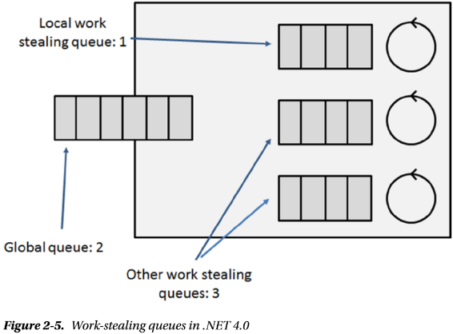
Figure 2-5

Slide 108
Thread Pool Heuristics in .NET 4.0
As mentioned earlier, .NET 3.5 changed the maximum number of threads in the thread pool to 250 threads per core.
However, we also noted that the main resource that the threads are consuming is memory.
Therefore, in .NET 4.0 the maximum number of threads is determined by the amount of memory available (on most modern machines it will be 1,023 worker threads and 1,000 I/O threads).

Slide 109
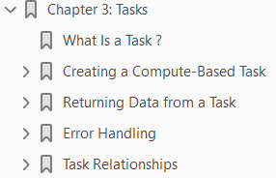
3
Tasks

Slide 110
Intro
With the release of .NET 4.0, Microsoft introduced yet another API for building asynchronous applications:
the Task Parallel Library (TPL)
The key difference between TPL and previous APIs is that TPL attempts to unify the APM.
It provides a single type called a Task to represent all asynchronous operations.
In addition to Tasks, TPL introduces standardized cancellation and reporting of progress—traditionally something developers rolled for themselves.
This chapter will examine these new constructs and how to take advantage of them to perform asynchronous operations.

Slide 111
What Is a Task?
A Task represents an asynchronous unit of work.
This work could be, for example, to calculate a value based on some inputs, or it could represent a request to a network-based resource.
It is important to recognize that this single item, called a Task, simply represents an activity that is ongoing while the main thread of execution continues.
Tasks are not some new, magical way of performing asynchronous work; they are an abstraction over the underlying mechanics we discussed in Chapter 2.
We can generally consider tasks to be either
Compute based, and thus bound to some kind of OS thread, or
I/O based, and thus modeled around I/O completion ports
But as you will discover in later chapters, they really can represent anything running asynchronously.

Slide 112
Creating a Compute-Based Task
When learning any new language or technology, there is a style of program you just have to build as part of your journey to greater things—yes, you guessed it, asynchronous “Hello World.”
The code in Listing 3-1 is very similar to the thread examples in Chapter 2.
When creating the Task object, a method is supplied that matches the signature of the Action delegate.
This delegate represents the work to run asynchronously.
The asynchronous operation will be deemed to have completed when the Speak method completes.
You may feel that this trivial example is not worth running; however, please do so as it may not do what you expect.
For best effect, run it outside the debugger with CTRL+F5.
If it is your lucky day, “Hello World” will appear on your screen.
But run the code a few times and you may well get different results; for most people absolutely nothing will be displayed.
We hope you have figured out the reason: compute-based tasks run on background threads and, as explained in Chapter 2, background threads do not keep the process alive.

Slide 113
Creating a Compute-Based Task |
By the time the task is about to run, the main thread has already terminated and, hence, the process will terminate as well.
This is an important point to remember, as when it comes to your own code, running tasks will simply be aborted if no foreground threads are executing.
So how can you bring some determinism to this chaotic example?
What you need to do is to keep the main thread alive until the asynchronous work has completed.
A simple Console.ReadLine( ); would suffice, but a more elegant way would be to block the main thread, wait for the task to complete, and then exit (see Listing 3-2).
So far we have created and started tasks as two separate statements.
It turns out this is not typical for compute-based tasks.
We can actually create and start the task as a single statement –

Slide 114

Creating a Compute-Based Task ||
In .NET 4.5 it is made even simpler: if you just require a task configured using some predefined defaults, you can use:
For the remainder of this chapter we will favor the factory-style approach as it will work in .NET 4.0 and 4.5.
It also provides more flexibility to configure the task’s behavior, something you will use in subsequent chapters.
As mentioned earlier, compute-based tasks run on OS threads, so where does this thread come from?
There are two obvious possibilities:
either a new thread is created, or
you schedule the work to run on a reusable thread pool thread
As you will see in later chapters, to make your application fast and fluid and scalable, you may be creating lots of small, asynchronous units of work.
It is therefore logical that, by default, compute-based tasks are assigned to thread pool threads.
To confirm this, you can run the code in Listing 3-3.

Slide 115
Long Running Tasks
So what if you want to have a long-running, asynchronous operation?
As mentioned in Chapter 2, using a thread pool for this purpose would be considered an abuse of the thread pool.
However, the creators of the TPL wanted to ensure that users have a uniform API irrespective of the type of asynchronous operation;
you don’t want to have to resort to old-style APIs.
When you create a task, in addition to supplying the Action delegate, hints can be supplied on how to create the task.
These hints are known as task creation options and are represented as the enumeration type TaskCreationOptions.
Listing 3-4 shows the creation of a long-running task.
Long-running tasks will run on their own, newly created, dedicated thread, which is destroyed once the task has completed.
There are many more creation options, and the options can be combined using the | operator.
We will discuss the other options as required throughout this book.

Slide 116
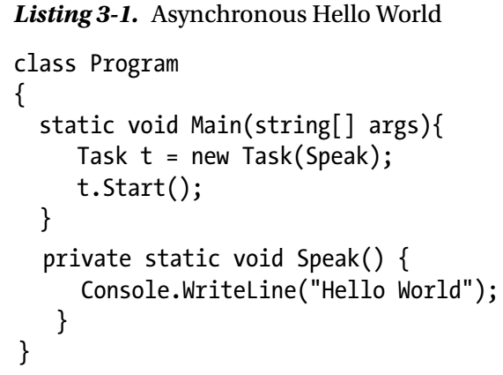
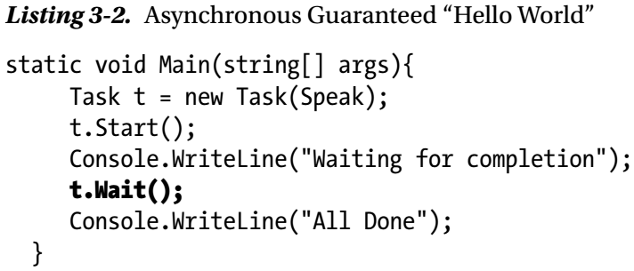
Listing 3-1 || 3-2

Slide 117
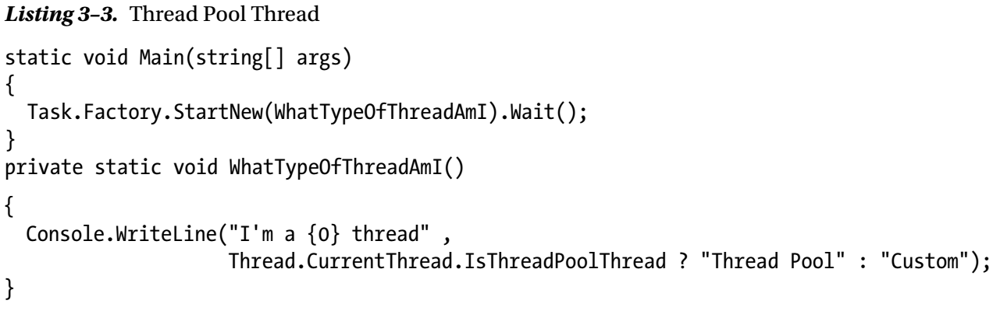
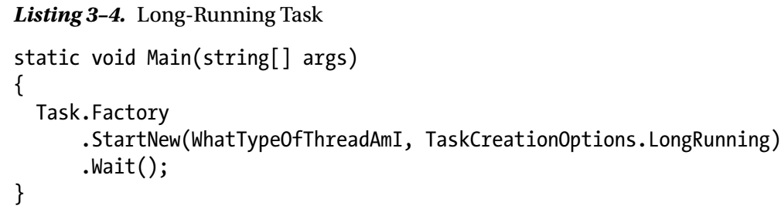
Listing 3-3 || 3-4

Slide 118
Passing Data into a Task
So far you have simply created a task and assumed the method has all the necessary information to perform its function.
Just as you generalize methods by adding parameters, you will want to do the same for tasks.
You have seen that the StartNew method takes an Action delegate; this delegate takes no inputs and returns void.
Consider the code in Listing 3-5.
The Import method takes no inputs and outputs and so, from what you have read so far, it could be executed as a Task body.
But what if we want to pass the directory to import?
It turns out there is another delegate type that the StartNew and Run method will take to represent the task body, Action<object>.
This allows you to supply a method that takes a single parameter of type object (Listing 3-6).
This approach does seem rather restrictive and smelly, but is certainly one of the most efficient ways of passing data to a task body.

Slide 119
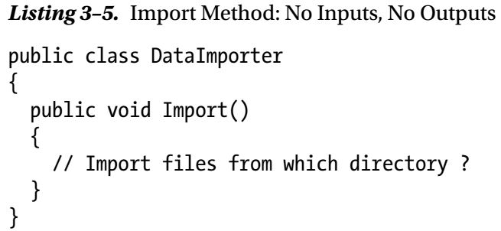
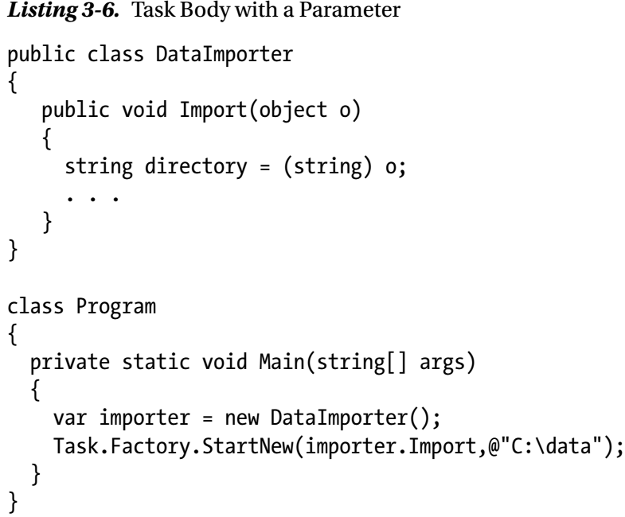
Listing 3-5 || 3-6

Slide 120
Alternative Approach
Another possibility is to have the data for the Import method supplied via instance fields of the DataImporter class (Listing 3-7).
This would then allow use of the simple Task.Factory.StartNew(importer.Import) with an Action delegate.
However, this is not always convenient, as a single DataImporter may want to allow different import sources over time.
Fortunately, .NET 2.0 and later versions support closures via anonymous methods (and lambdas in .NET 3.5).
This allows you to make use of the compiler to build a class that contains
all the items you want to flow into the task,
plus a small method that ultimately calls the asynchronous functionality (Listing 3-8)
Closures make passing data into a task very simple, and they are therefore the norm for passing data into tasks.
They are not as efficient as passing in a single object, but they keep the code simple and easy to understand.

Slide 121
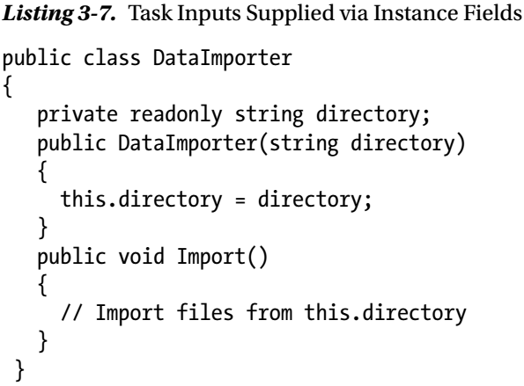
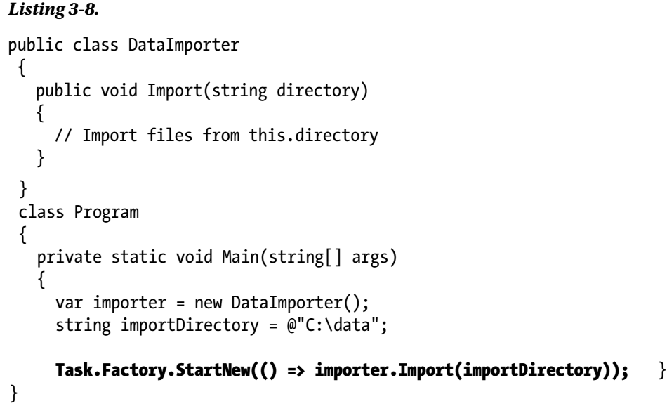
Listing 3-7 || 3-8

Slide 122
CLOSURES
During compilation, the compiler builds a class that contains
an instance method containing the code used as part of the lambda, and
public fields to hold any data the instance method requires from the outer scope
The Listing C-1 is an example of what the class may look like.
This class is instantiated when the first of the local variables used in the lambda is declared.
The local variables are now no longer accessed directly via the stack, but instead via a stack-based reference to an instance of this generated class.
The compiler then builds a delegate that matches the Action delegate pointing to the class instance method ClosureMethod.
This method will obviously have access to the instance fields, and thus have access to the outer scope variables.
The Listing C-2 shows an example of how the C# compiler will rewrite Main to achieve the closure.

Slide 123
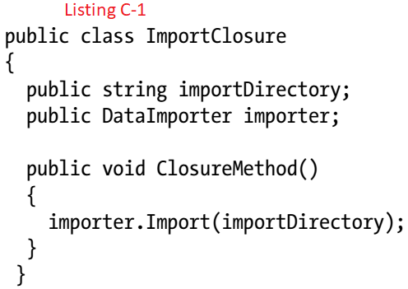
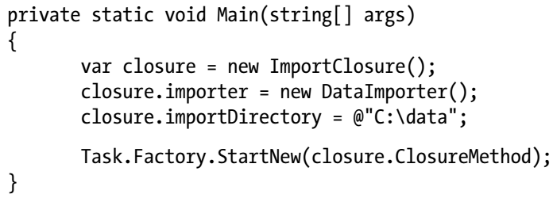
Listing C-1 || C-2

Slide 124
Dangers of Closures

Slide 125
Returning Data from a Task

Slide 126
Creating I/O-Based Tasks

Slide 127
Error Handling

Slide 128
Ignoring Errors

Slide 129
.NET 4.0

Slide 130
.NET 4.5

Slide 131
Designing Task-Based APIs

Slide 132
Cancellation

Slide 133
Progress

Slide 134
Task Relationships

Slide 135
Chaining Tasks (Continuations)

Slide 136
Why Use Continuations?

Slide 137
Nested and Child Tasks

Slide 138
Why Use Child Tasks?

Slide 139
4
Basic Thread Safety

Slide 140
Intro
In the last two chapters, we looked at numerous ways of starting work that will run asynchronously.
However, in all of the examples, that work has been relatively self-contained
Asynchrony opens up a whole new class of bugs that can infect your code:
race conditions
deadlocks
data corruption
to name just three.
We will look at how you debug asynchronous code in Chapters 13 and 14, but our starting point has to be how to prevent these issues in the first place.
In this chapter, we will examine the need for thread safety and then introduce the primary tools used to achieve it.
In Chapter 5, we will take this idea further and look at the constructs introduced in .NET 4.0 that take some of the work off our shoulders.

Slide 141
Asynchrony and Data

Slide 142
The Interlocked Class

Slide 143
Monitor: The Workhorse of .NET Synchronization

Slide 144
Optimizing for Read

Slide 145
A Semaphore Out of the Box

Slide 146
Raising the Starting Gate: ManualResetEventSlim

Slide 147
CountdownEvent: Simplifying Fork and Join

Slide 148
Barrier: Rendezvous-Based Synchronization

Slide 149
Crossing the AppDomain Boundary with WaitHandle

Slide 150
Synchronization Is Not the Only Answer

Slide 151
5
Concurrent Data Structures

Slide 152
Intro
In the previous chapter we introduced the need to consider thread safety when sharing state across multiple threads.
The techniques demonstrated required the developer to understand the possible race conditions and select the cheapest synchronization technique to satisfy thread safety.
These techniques, while essential, can often become tedious and make the simplest of algorithms seemingly overly complicated and hard to maintain.
This chapter will explore the use of built-in concurrent data structures shipped with TPL that will simplify our multithreaded code while maximizing concurrency and efficiency.

Slide 153
Simplifying Thread Safety

Slide 154
Lazy<T>

Slide 155
Concurrent Collections

Slide 156
ConcurrentDictionary<K,V>

Slide 157
Locking Mechanics

Slide 158
ConcurrentQueue<T> and ConcurrentStack<T>

Slide 159
ConcurrentBag<T>

Slide 160
Blocking Collections

Slide 161
Graceful Shutdown

Slide 162
Consuming Enumerable

Slide 163
BlockingCollection of X

Slide 164
6
Asynchronous UI

Slide 165
7
async and await

Slide 166
8
Everything a Task

Slide 167
9
Server-Side Async

Slide 168
10
TPL Dataflow

Slide 169
11
Parallel Programming

Slide 170
12
Task Scheduling

Slide 171
13
Debugging Async with Visual Studio

Slide 172
14
Debugging Async - Beyond Visual Studio

Slide 173
volatile Keyword
Host of CLR – SQL Server
Process and Thread Priority

Slide 174
volatile Keyword
The volatile keyword indicates that a field might be modified by multiple threads that are executing at the same time.
Fields that are declared volatile are not subject to compiler optimizations that assume access by a single thread.
This ensures that the most up-to-date value is present in the field at all times.
The volatile modifier is usually used for a field that is accessed by multiple threads without using the lock statement to serialize access.
The volatile keyword can be applied to fields of these types:
Reference types.
Pointer types (in an unsafe context). Note that although the pointer itself can be volatile, the object that it points to cannot. In other words, you cannot declare a "pointer to volatile.“
Types such as sbyte, byte, short, ushort, int, uint, char, float, and bool.
An enum type with one of the following base types: byte, sbyte, short, ushort, int, or uint.

Slide 175
volatile Keyword |
Generic type parameters known to be reference types.
IntPtr and UIntPtr.
The volatile keyword can only be applied to fields of a class or struct.
Local variables cannot be declared volatile.

Slide 176
Host of CLR – SQL Server
Some hosts of the CLR, such as Microsoft SQL Server 2005, provide their own thread management.
A host that provides its own thread management can move an executing task from one physical operating system thread to another at any time.
Most tasks are not affected by this switching.
However, some tasks have thread affinity - that is, they depend on the identity of a physical operating system thread.
These tasks must inform the host when they execute code that should not be switched.
For example, if your application calls a system API to acquire an operating system lock that has thread affinity, such as a Win32 CRITICAL_SECTION, you must call BeginThreadAffinity before acquiring the lock, and EndThreadAffinity after releasing the lock.
Using this method in code that runs under SQL Server 2005 requires the code to be run at the highest host protection level.

Slide 177
Process and Thread Priority
Different processes can run with different priorities (there are six priorities ranging from idle to real time).
Within a process a thread also has a priority; there are seven ranging from idle to time critical.
Process.PriorityClass Property Gets or sets the overall priority category for the associated process.
ProcessPriorityClass Enumeration indicates the priority that the system associates with a process as shown in Figure P-1.
This value, together with the priority value of each thread of the process, determines each thread's base priority level.
Thread.Priority Property Gets or sets a value indicating the scheduling priority of a thread Figure P-2.
ThreadPriority Enumeration specifies the scheduling priority of a Thread.

Slide 178
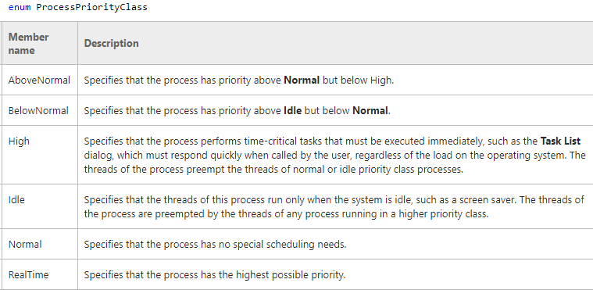
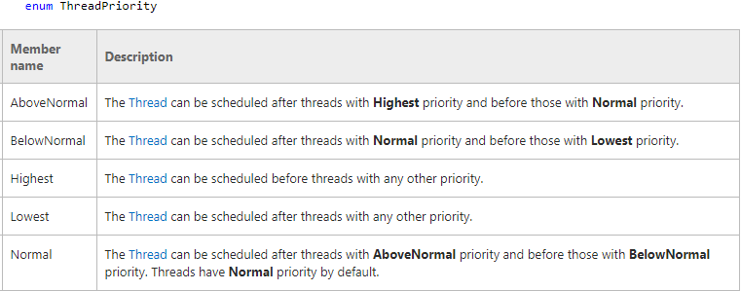
Figure P1 || P2

